Slide 1
Predicting Forest Fires
Team Fire Squad: Tiffanie M. Mac Donald, Jonathan David Ortiz, Sanjeet Saikia, Jackson F. Shands, Raya Young
Notes:
SANJEET

Slide 2
Introduction
Natural (wild) forest fires have a great impact on the natural ecosystem and survival of our species.
Control of these occurrences are vitally important to the health of the planet.
Montesinho Natural Park is a naturally forested area that is susceptible to forest fires, has been a focus of study as it is also a popular area for tourists to visit.
Climate change introduces increased frequency of severe weather events which includes increased risk of forest fires.
Notes:
SANJEET
Natural weather phenomena have great ecological impact- displacing people, and impacting animal populations. Changing climate conditions could mean that the frequency of these events is ever-increasing, urging a necessary evolution in the way we collect, analyze, and make predictions on weather data. Forested areas are vitally important to the health of the planet, contributing oxygen and humidity, and regulating soil quality to prevent other phenomena like landslides. Protecting forested areas is as important to the health of the planet as well as the well-being of local populations.

Slide 3
Motivation
As phenomenon such as global warming becomes more prevalent, weather event data can be used to make predictions and create more actionable insights to:
Create solutions to lessen damage
Prepare for seasonal impact
Reduce number of those affected, and reduce costs of recovery and restructuring
Notes:
SANJEET
In analyzing meteorological and other environmental data (like past natural phenomena, weather metrics, and animal populations), we can use the information to make predictions and create actionable insights to prepare for seasonal impact, and even create solutions to lessen the damage.
In doing so, we can reduce the numbers of those affected, reducing costs of recovery and restructuring; preserve ecological integrity, and even create solutions to help strengthen the environment for future events.
MENTION AUSTRALIA

Slide 4
Problem Statement
A forest fire data set sourced from the UCI Machine Learning Repository, utilizing a combination of meteorological data and spatial coordinates were used to provide insight about forest fires in Montesinho Park, located in the northeast region of Portugal.
Analysis of this dataset will use data mining techniques, such as classification methods including Decision Tree Analysis, Naive Bayes, Support Vector Machines and Random Forest to identify the combination of values that contribute to the likelihood of a significant forest fire.
Notes:
SANJEET

Slide 5

About the data
Conditional codes
FFMC - Fine Fuel Moisture Code
DMC - Duff Moisture Code
DC - Drought Code
Fire Behavior Indices
ISI - Initial Spread Index
RH - Relative Humidity
AREA - Physical forest area burned
Other variables:
Temp
Wind
Rain
If an area burned was less than 1ha/100 = 100m2, the dataset rounded down to 0.
Notes:
TIFFANIE - talk about this slide too
Department of Information Systems, University of Minho, Portugal.
Number of Instances: 517
6. Number of Attributes: 12 + output attribute
Note: several of the attributes may be correlated, thus it makes sense to apply some sort of
feature selection.
7. Attribute information:
For more information, read [Cortez and Morais, 2007].
1. X - x-axis spatial coordinate within the Montesinho park map: 1 to 9
2. Y - y-axis spatial coordinate within the Montesinho park map: 2 to 9
3. month - month of the year: "jan" to "dec"
4. day - day of the week: "mon" to "sun"
5. FFMC - FFMC index from the FWI system: 18.7 to 96.20
6. DMC - DMC index from the FWI system: 1.1 to 291.3
7. DC - DC index from the FWI system: 7.9 to 860.6
8. ISI - ISI index from the FWI system: 0.0 to 56.10
9. temp - temperature in Celsius degrees: 2.2 to 33.30
10. RH - relative humidity in %: 15.0 to 100
11. wind - wind speed in km/h: 0.40 to 9.40
12. rain - outside rain in mm/m2 : 0.0 to 6.4
13. area - the burned area of the forest (in ha): 0.00 to 1090.84
8. Missing Attribute Values: None
three Fuel moisture codes are collected, the Fine Fuel Moisture Code (FFMC), Duff Moisture Code (DMC) and Drought Code (DC). Together with the Meteorological data, they yield the Fire Behavior Indices, Initial Spread Index (ISI) and Buildup Index (BUI) which are combined to compute the Fire Weather Index (FWI).
Fine Fuel Moisture Code
The Fine Fuel Moisture Code (FFMC) is a numeric rating of the moisture content of litter and other cured fine fuels. This code is an indicator of the relative ease of ignition and the flammability of fine fuel.
Duff Moisture Code
The Duff Moisture Code (DMC) is a numeric rating of the average moisture content of loosely compacted organic layers of moderate depth. This code gives an indication of fuel consumption in moderate duff layers and medium-size woody material.
Drought Code
The Drought Code (DC) is a numeric rating of the average moisture content of deep, compact organic layers. This code is a useful indicator of seasonal drought effects on forest fuels and the amount of smoldering in deep duff layers and large logs.
Initial Spread Index
The Initial Spread Index (ISI) is a numeric rating of the expected rate of fire spread. It combines the effects of wind and the FFMC on rate of spread without the influence of variable quantities of fuel.

Slide 6
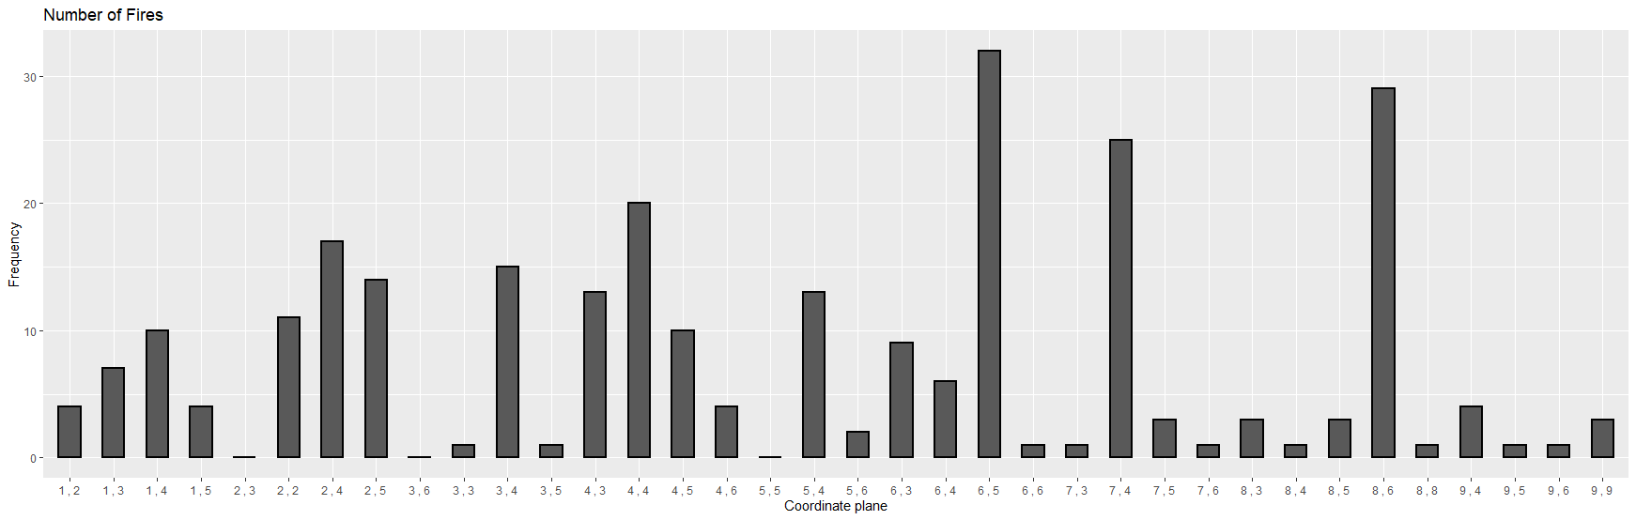
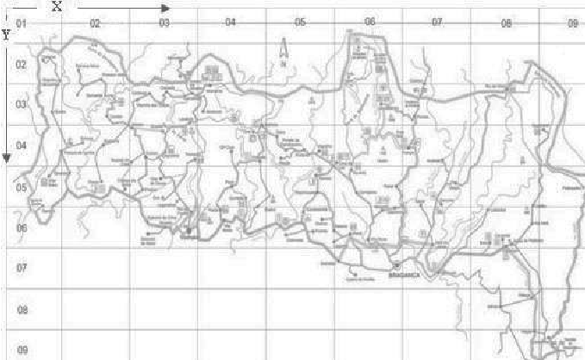

Most burned area and most fires are (“6,5”, “8,6”, “7,4”,”2,4”,”4,4”)
Average area burned : 185 Hectares
Average number of fires : 8 fires over .5 Hectares
Notes:
TIFFANIE

Slide 7
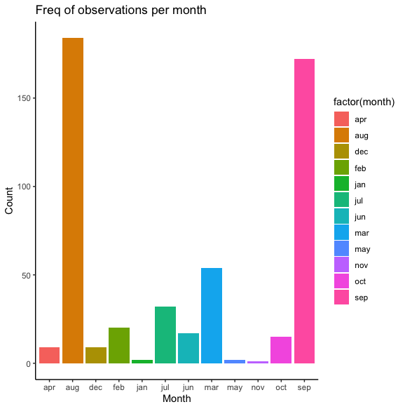
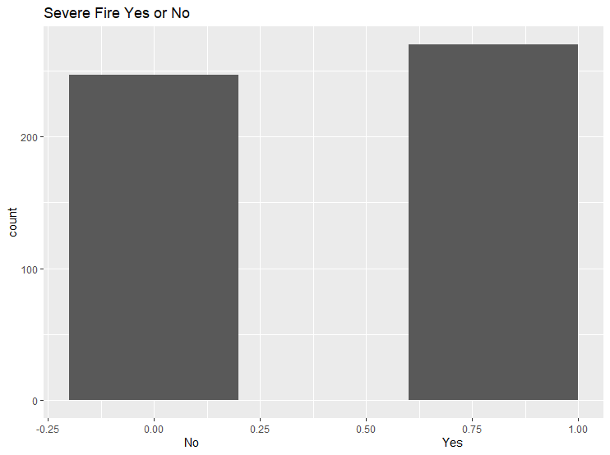
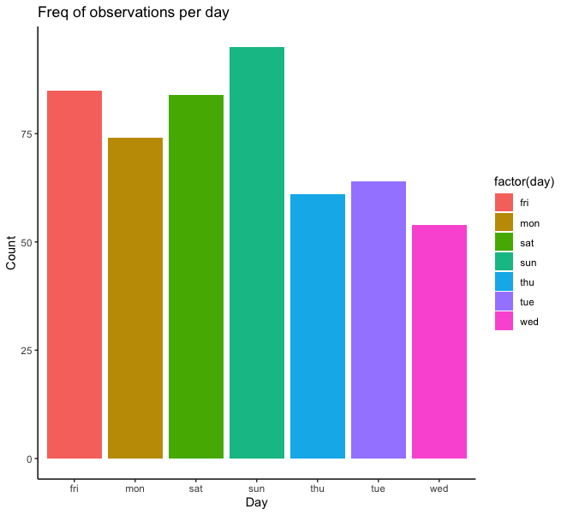
Exploratory Data Analysis
This plot shows the distribution of fires by day of the week. However, information was only recorded when there was a burn, and did not indicate dates or chronology.
Burn area was transformed into a binary variable, indicating if there was a significant fire or not. This plot shows a nearly even distribution of this variable, with 248 ‘No’ and 269 ‘Yes’
Most significant fires occurred in the months of August and September
Notes:
TIFFANIE
How many 0s vs. 1s
Avg is 0.52 so basically half and half (517 rows) Data is not skewed, pretty balanced.
248 vs. 269
Jonathan - Update to ggplot histogram
Emphasize the months the most fires happened

Slide 8
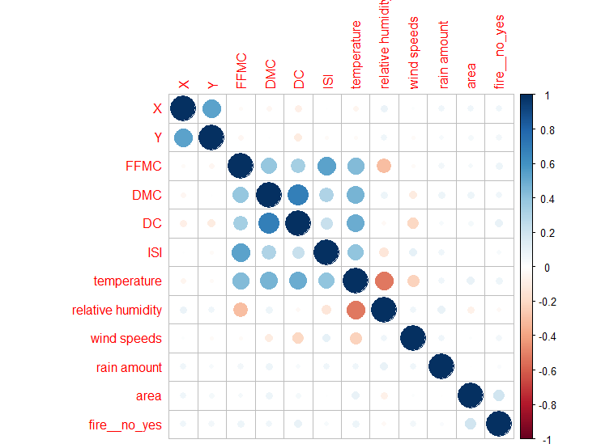
Correlation
No strong correlations between variables and if there was a fire that day or how much of the area was burned.
Notes:
TIFFANIE
Nothing that was too obvious - exploration is necessary!

Slide 9
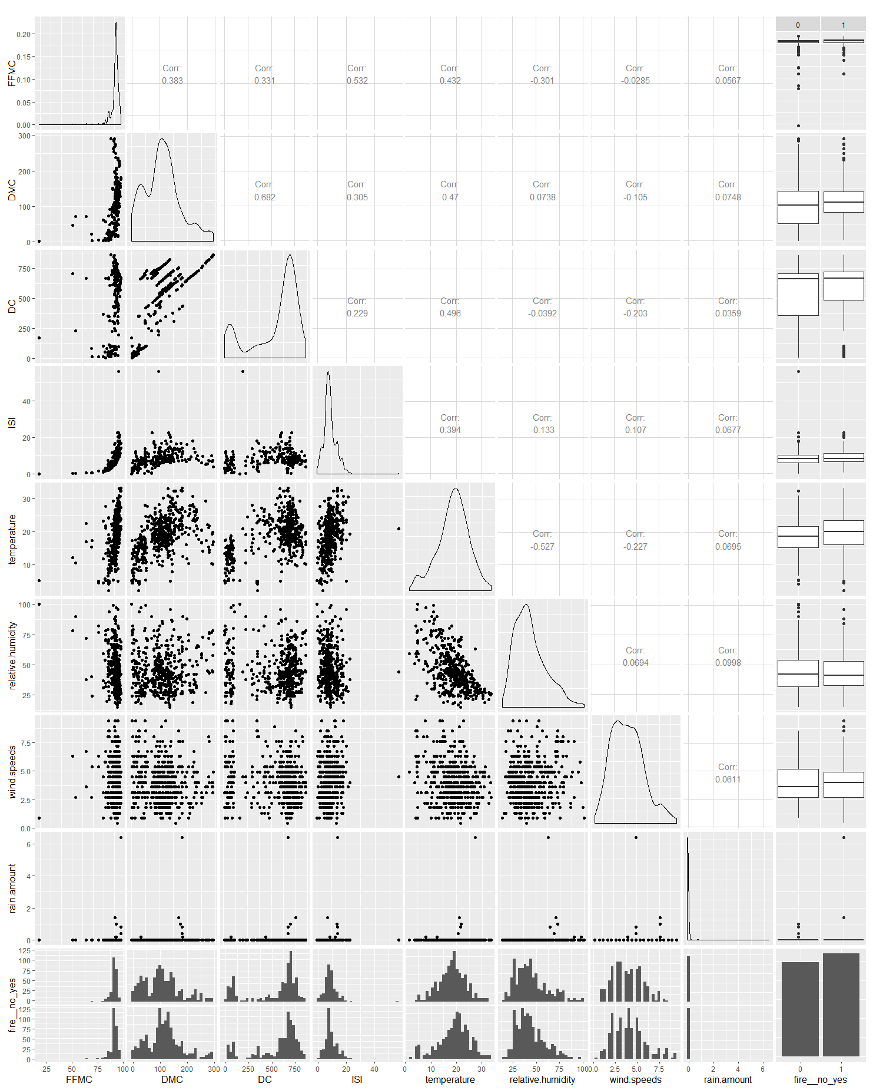
Notes:
TIFFANIE
Generated using ggpairs()
Took out month and day variables, x and y in order to focus on FFMC through no_yes

Slide 10
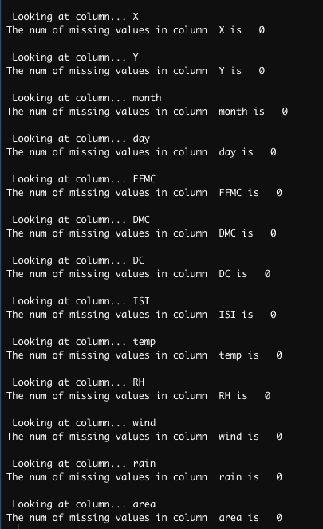

Preparing the data
Cleaning + prep
*No null values
Transformed Area burned into a binary variable and removed area burned
Geographic data
Dates
Special Indexes
Library -> (Dplyr)
Num & Str converted Factors
Notes:
TIFFANIE -
Discuss each variable, what the different acronyms mean (see table in following slide)
Talk about time series, no chronology
DIscuss hectare 0-1
Discuss how ‘0’ was actually rounded down
Omitted NAs, but original data set contained 0

Slide 11
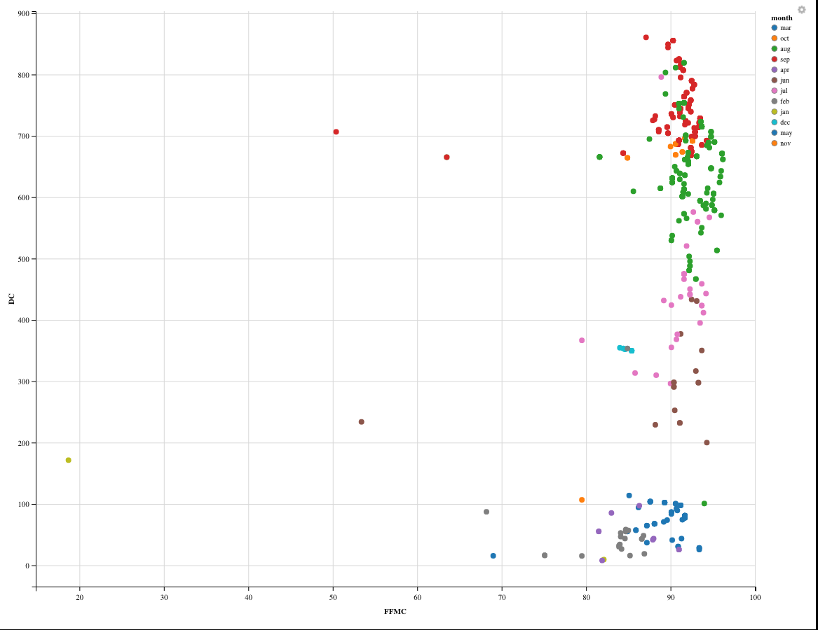
Clustering - kMeans
K-Means set up
Scaled data
Dropped ( month, day, X,Y)
Plotted points to find separation of data
Notes:
JACKSON
https://zoom.us/j/134963576

Slide 12
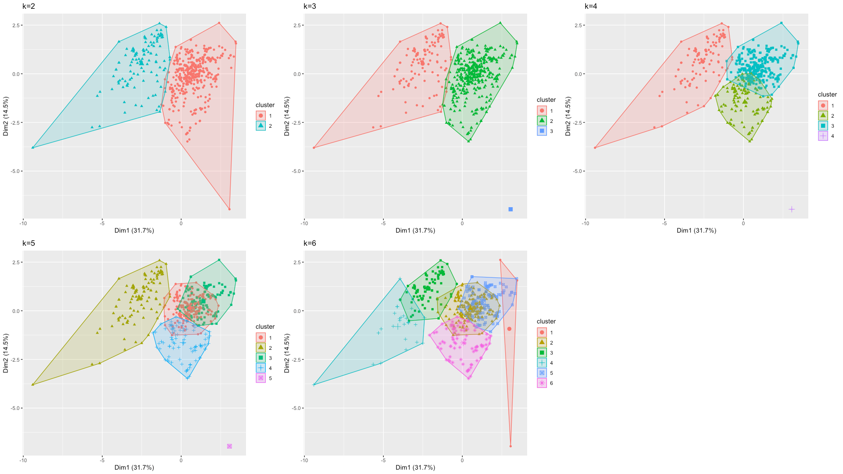
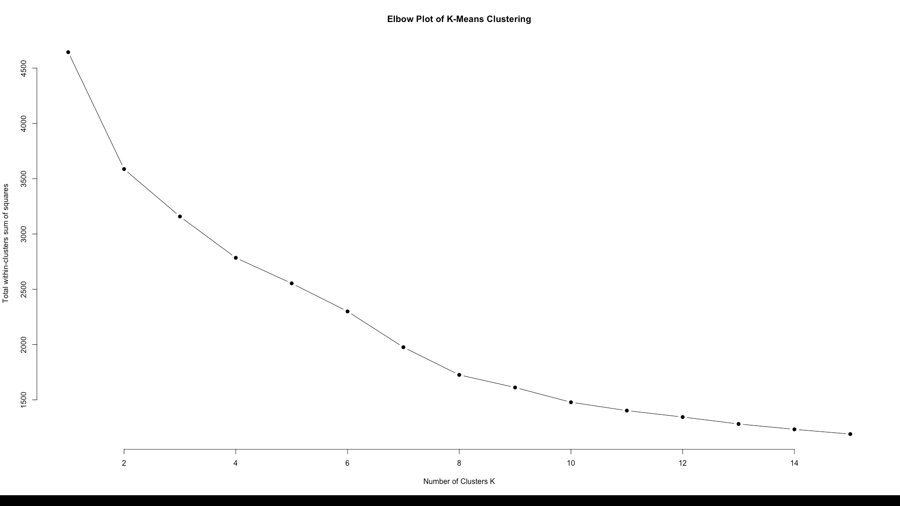
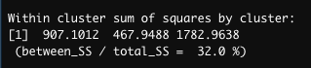
Clustering - K means
Cluster 3
Notes:
JACKSON

Slide 13
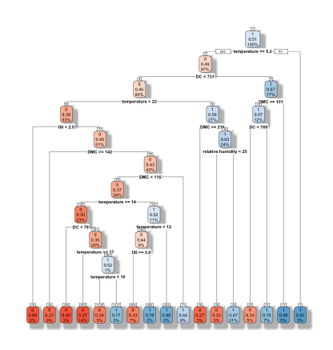
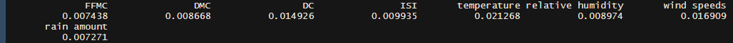
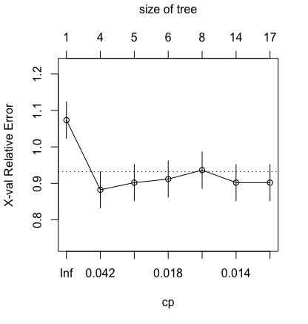
Decision Trees seed(123)
The first tree used a seed of 123 and reflected a 21% chance of a significant burn area when the Relative Humidity less than 25. This tree first split at Temperature, then branched into DC, then Temperature and DMC.
Info Gain :
The accuracy for this model 51%.
Notes:
Four different decision trees were generated to investigate which of the attributes would best predict a significant burn area.
The trees were varied according to the set.seed() parameter for reproducibility.
Info gain, temp

Slide 14
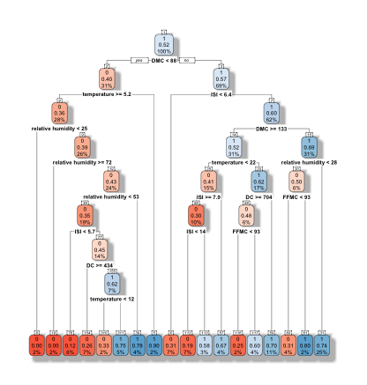
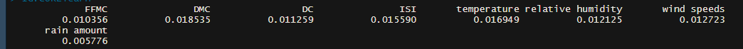
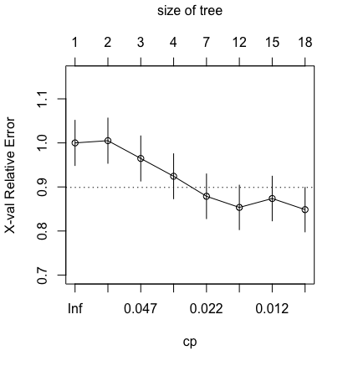
Decision Trees seed(1016)
The second model generated used a seed of 1016 and reflected a 25% chance of a significant burn area when the Relative Humidity less than 28. This tree first split at DMC, then branched into Temperature and ISI.
INFO GAIN:
The accuracy for this model is 52%
Notes:
This tree used a seed of 1016 and reflected a 25% chance of a significant burn area when the Relative Humidity less than 28. This tree first split at DMC, then branched into Temperature and ISI.
Info gain DMC

Slide 15
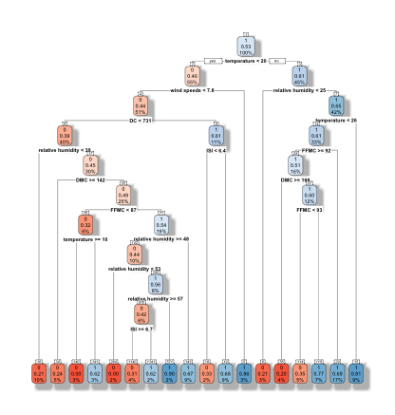
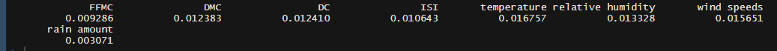
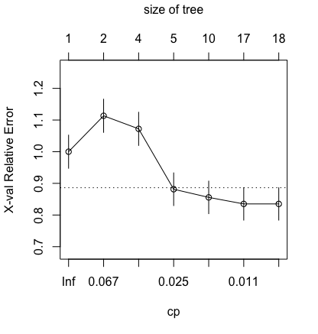
Decision Trees seed(69)
Finally, the third tree used a seed of 69 and reflected a 17% chance of a significant burn area when the FFMC was greater than or equal to 92. This tree first split at temperature, then branched into wind speeds and relative humidity.
INFO GAIN :
The accuracy for this model is 53%.
Notes:
Info gain temperature

Slide 16
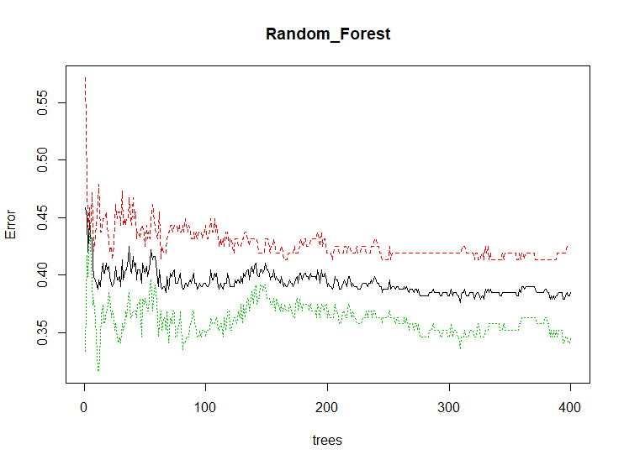

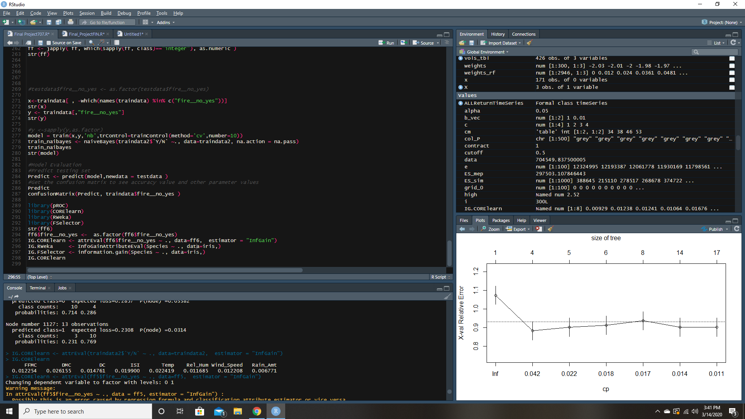
Random Forest
Number of trees : 400
Accurate : 55%
False Negative : 49 %
Out Of Bag Error : 38%
Number of splits tried : 6
Information gain:

Slide 17
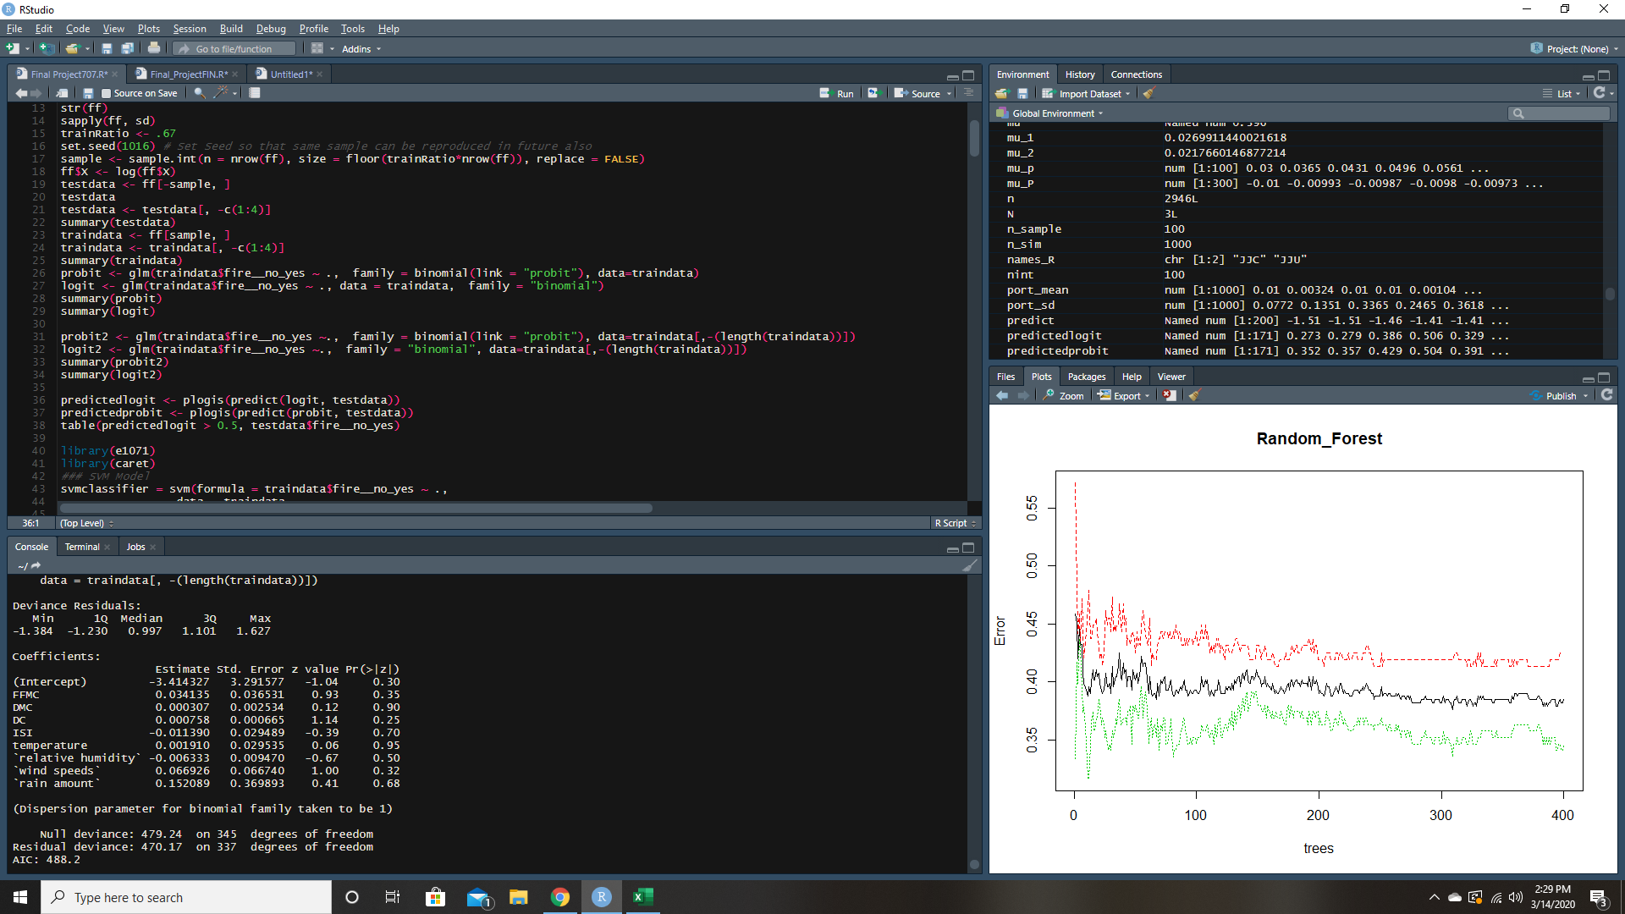

Logistic Regression: Logit
None of our variables seem to be statistically significant
Using this in conjunction with our other findings is difficult
Variable significance does not coincide with decision tree and naive bayes findings
Running all possible combinations of our variable the lowest p value for a variable is wind speed at .056 then DC at .12
With all combinations errors were skewed False Negatives from 62% - 75%

Slide 18
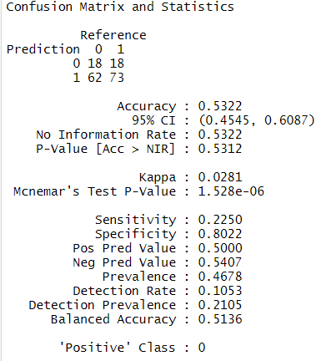
Naïve Bayes
Our goal with Naïve Bayes is to predict whether there was a fire or not based on the other predicting variables.
With the data prepared and spliced, or split into test and training sets, the preparation is done for analysis. The outcome is a class variable of 0 or 1.
The final output showed that the Naïve Bayes classifier could predict whether a fire would occur or not with a balanced accuracy of approximately 51.4%.

Slide 19
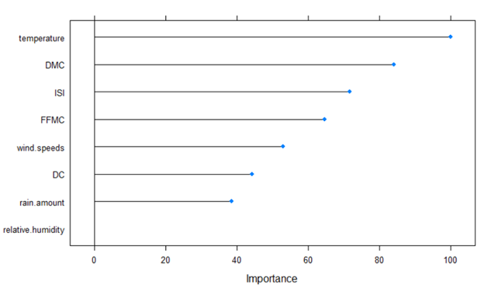
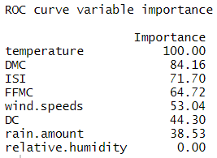
Variable Importance Evaluation
To summarize, the following plot shows how each predictor variable is independently responsible for predicting the outcome.
It is clear that ‘Temperature’ is the most significant variable for predicting the outcome in the Naïve Bayes model.

Slide 20



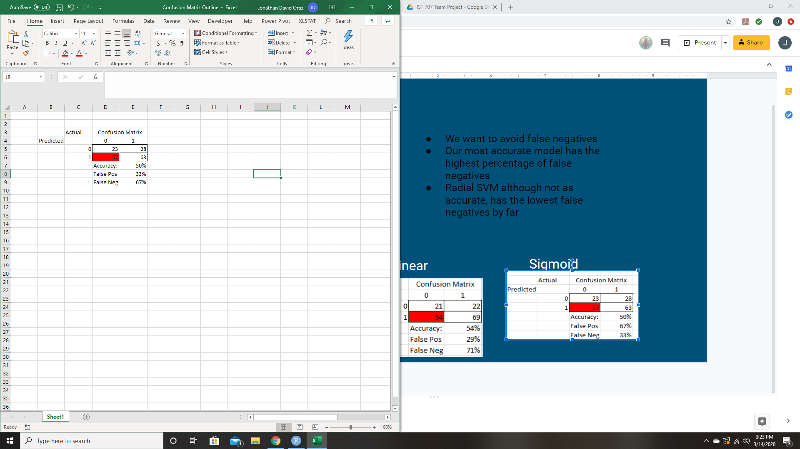
SVM Models
Radial
We want to avoid false negatives
Our most accurate model has the highest percentage of false negatives
Radial SVM although not as accurate, has the lowest false negatives by far and should be used to avoid predicting no fire when there is one
Polynomial
Linear
Sigmoid

Slide 21
Conclusions
In exploring the data, we found that while some models performed better than others, sometimes underperformance was more due to limitations of the dataset.
For example, unable to do time series analysis because days of week and months did not indicate chronological order.
Overall, the model which performed the best was Random Forest, with an accuracy of 55%, which is still not optimal.
Finally, from our analysis, we can see that more information is needed, but the detail gleaned from our exploration shows promising direction.
Other solutions could be determining specific areas of the forest most susceptible to burn, and installing monitoring systems for prevention and recovery such as water canons.

Slide 22
Resources
Citation web link
Dataset web link

